Slide 1
Mini Capstone Project
Crime Data Analysis with MySQL and Python
Yaswanth A

Slide 2
Content
Problem Statement
Location Analysis
Tools and Libraries
Crime Code Analysis
Database Setup and Import
Strategic Recommendations
Database Connection
Conclusion
Spatial Analysis
Victim Demographics

Slide 3
Problem Statement:
The cities are experiencing an increase in criminal activity, with significant challenges in identifying crime hotspots, understanding victim demographics, and analyzing the distribution of specific crime types. Law enforcement agencies struggle to allocate resources efficiently due to limited insights into where and when crimes occur most frequently. Additionally, there is a need to better understand the correlation between crime rates and factors such as victim age, gender, and location. To address these issues, a comprehensive data analysis of crime patterns, spatial trends, and victim characteristics is required to inform crime prevention strategies and optimize resource deployment.

Slide 4
Tools and Libraries
Tools
Mysql
Pycharm
Libraries
Pymysql
Pandas
Seaborn
Matplotlib

Slide 5
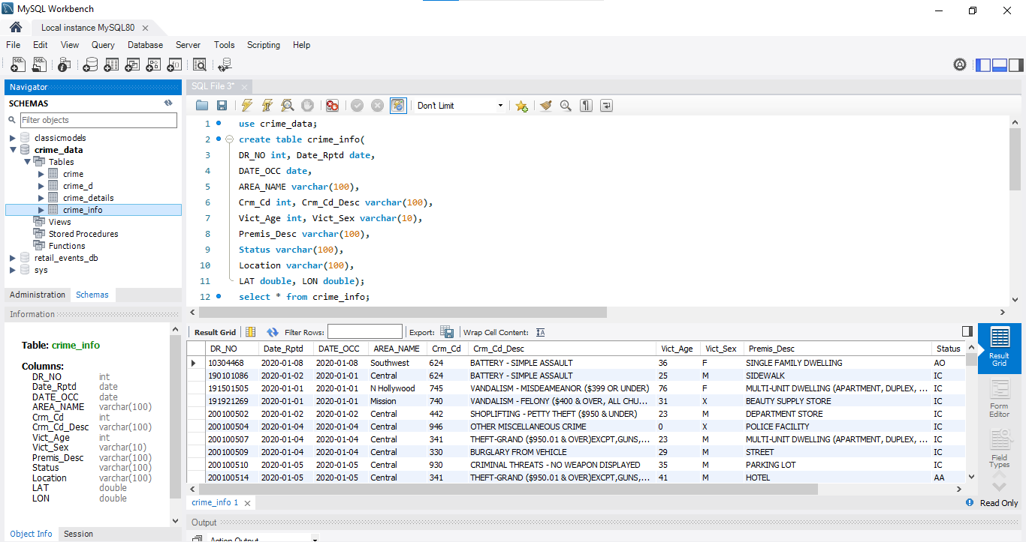
Database Setup and Import
I used Mysql database for importing crime data CSV file. The dataset includes information such as DR NO, Date Reported, Date Occurred, Area Name, Crime Code, Crime Code Description, Victim Age, Victim Sex, Premises Description, Status, Location, Latitude, and Longitude.

Slide 6
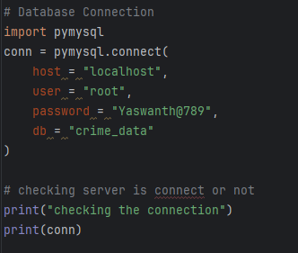
Database Connection
I used Pymysql lib to connect Mysql database

Slide 7
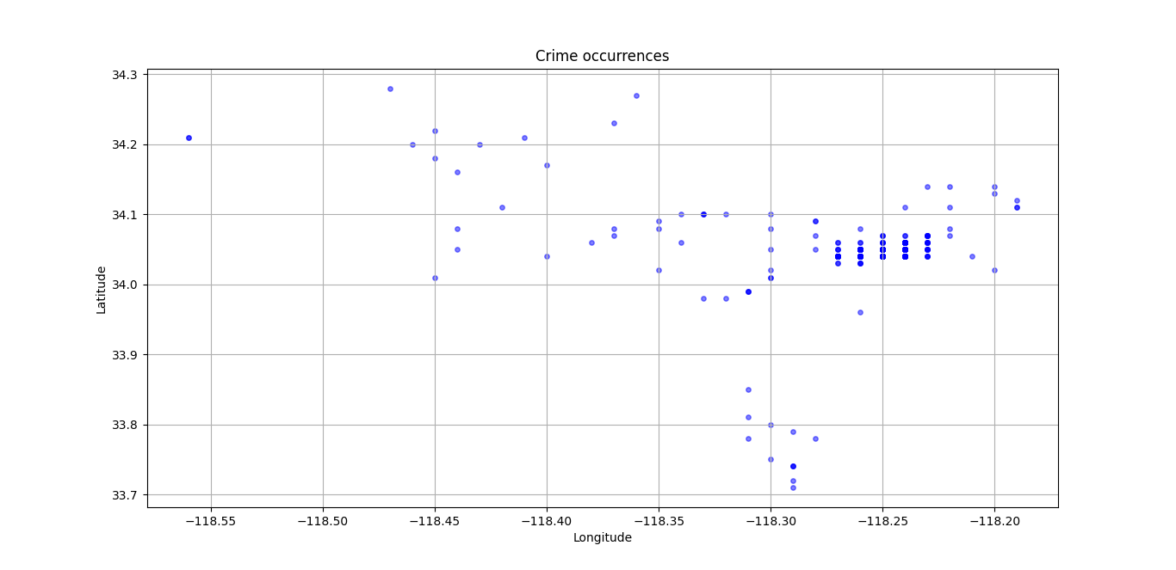
Spatial Analysis
From the analysis of the hotspot map for crimes,
I have concluded that Los Angeles is the hostspot country where most crimes have happened

Slide 8
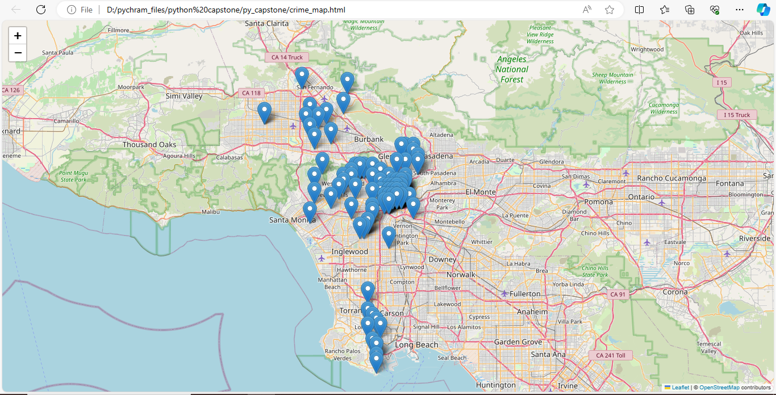

Slide 9
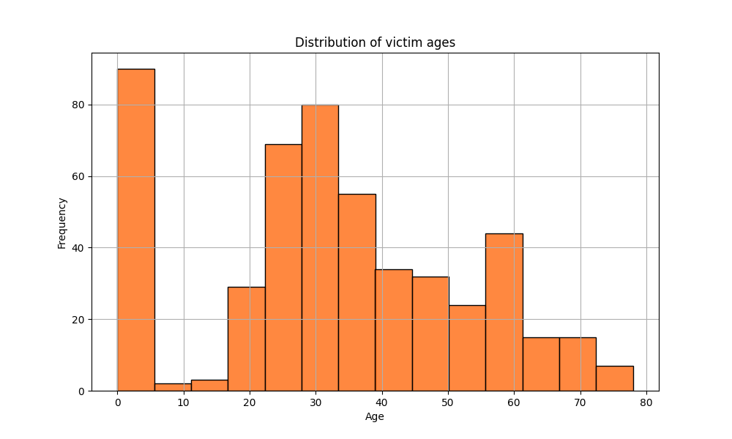
Victim Demographics
From the analysis of Histogram, In our dataset there are zero values in the age column where we can see that most of the crime happend in that age group of 0 to 5.The frequency of that age group is above 80
2. The age group of 23 to 35 the crime frequency is above 50
3. Some of the crimes has frequency less than 40 and the age group for those crimes
are (6-11) and (40-80)

Slide 10
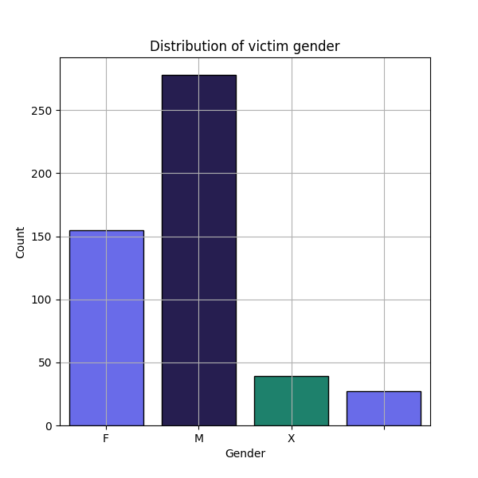
There is significant diffrence in male and female crime rates.
Males crime rates is more than 250.
The female have the crime rates is about 150.
The x victimes has crime rates less than 50.

Slide 11
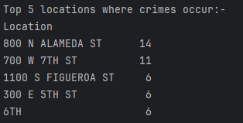
Location Analysis
This are the top five locations where crime occurrence is more

Slide 12
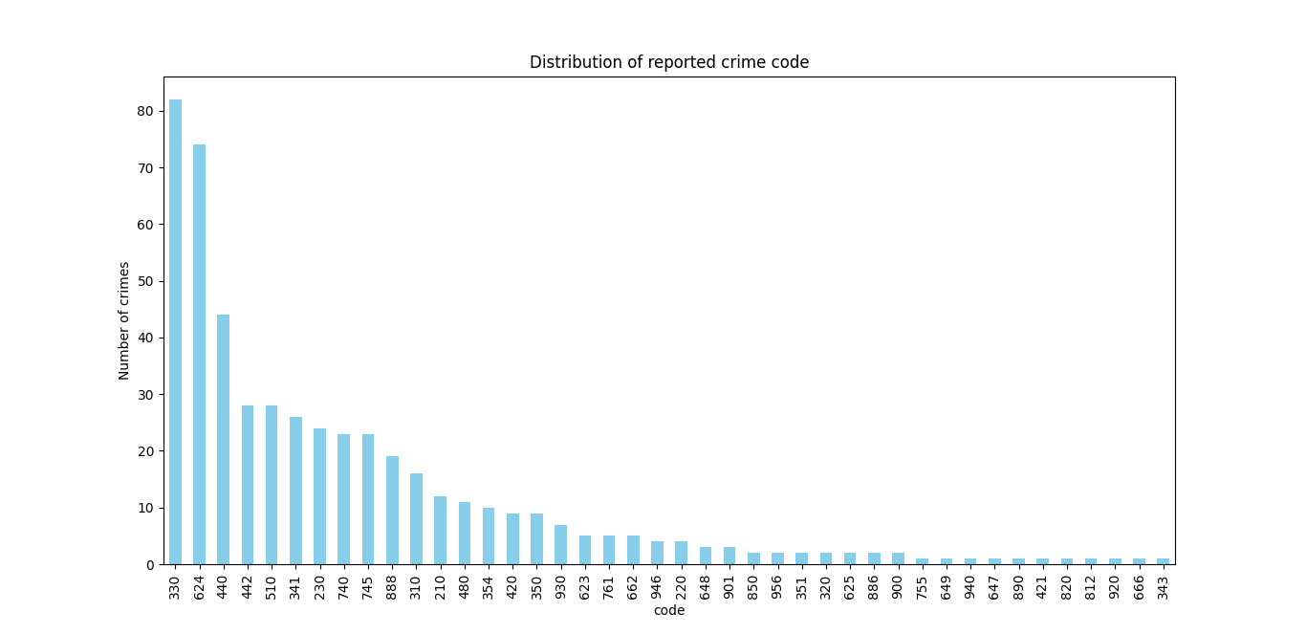
Crime Code Analysis
From below that the crime code 330 has the most occurance which is more than 82.
The crime code 624 has occured more than 74.

Slide 13
Strategic Recommendations:
Enhanced Law Enforcement in Crime Hotspots: Spatial analysis shows Los Angeles as a major hotspot for crimes. Concentrated law enforcement in these areas can help mitigate the problem.
Targeted Crime Prevention Programs: The age groups 0-5 and 23-35 show a high frequency of victimization. Initiatives aimed at protecting these vulnerable groups can help reduce crime rates.
Gender-Based Crime Response: With higher crime rates among males than females, developing male-focused crime prevention measures could be beneficial.
Crime-Specific Strategies: Crimes related to crime code 330 and 624 occur frequently. Tailored interventions targeting these crime types may yield positive results.

Slide 14
Conclusion :
The project provides valuable insights into crime distribution based on geography, age
groups, and gender, with a clear focus on crime codes. These findings can support data
driven decisions for optimizing crime prevention and resource allocation in high-risk
areas.
Datasets and code files: https://github.com/AYaswanth123/Crime-Data-Analysis-with-MySQL-and-Python

Slide 15
Thank You

